Slide 1

DIGIKUBE
Empowering Kelompok Usaha Bersama (KUBE) by Digitalization
Group 2 - Happy Digital X Program
19 June 2021

Slide 2
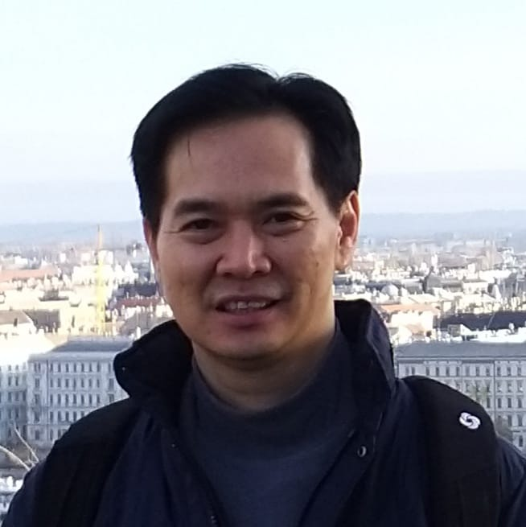
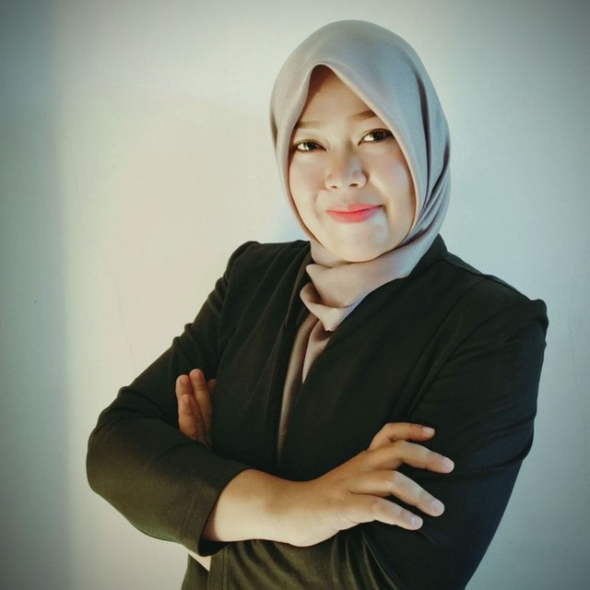


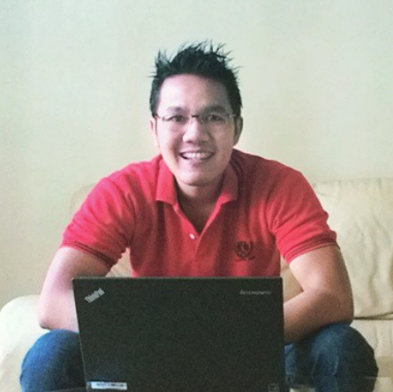

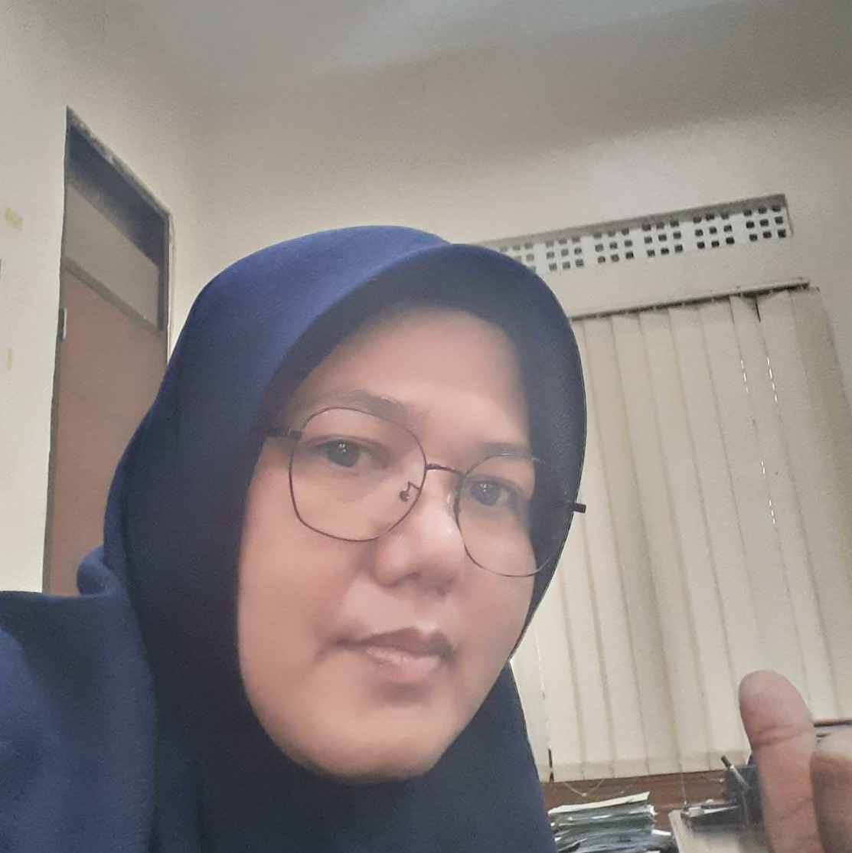
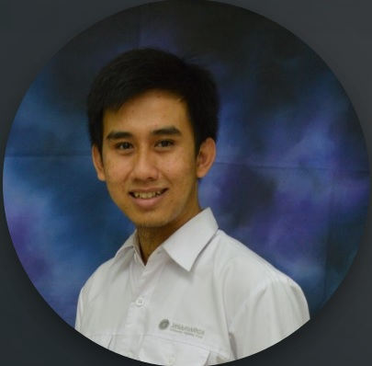
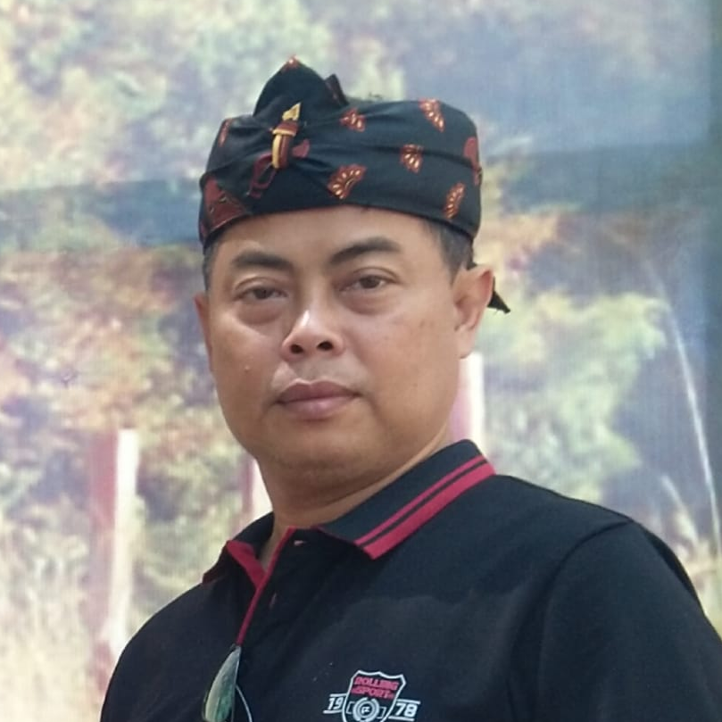
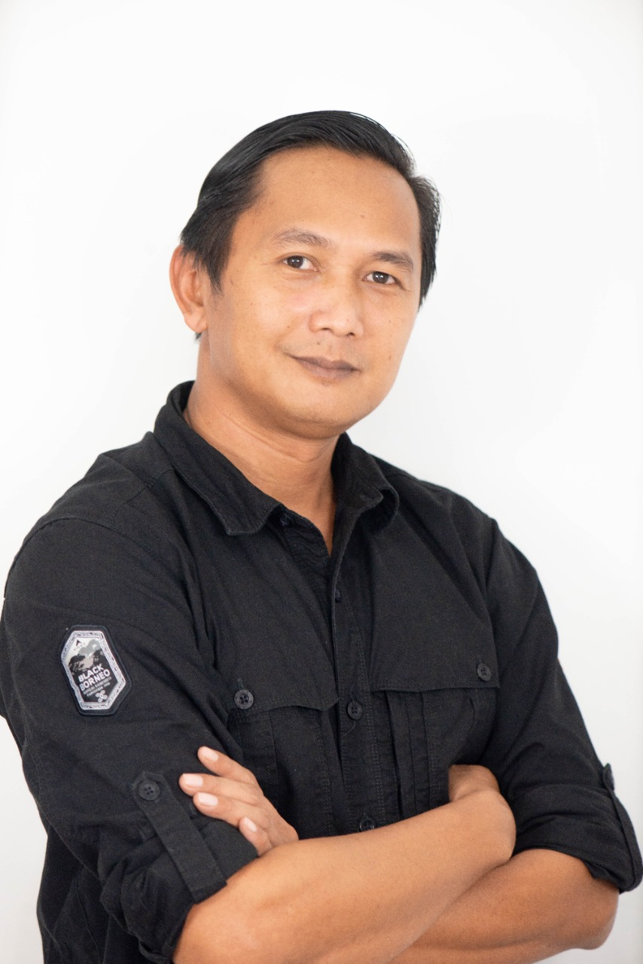
Our Team
Fenton Salim
Inaya Sari M
George K
Allicia Deana
Febi Ari W
M. Indrahanif
H Bubun A
Arief Syamsudin
Yanuarti KD
Gilang Permana
Team Leader
Entrepreneurship & Marketing Expert Team
IT & Knowledge Repository Builder Team
Featuring :
Social Empowerment Head Division
IT Developer
Stakeholder Engagement & Community Relation Team
Sumedang Government Representative Team

Slide 3
Our Progress
1st Meeting
Introduction and Roles Assignment
3rd Meeting
Meet with H Bubun as an expert in KUBE in Sumedang, detailing about every KUBE and their potential to develop
5th Meeting
Detailing about our challenges
31 May 2021
11 June 2021
29 May 2021
4 June 2021
17 June 2021
2nd Meeting
Brief explanation about KUBE in Sumedang by one of the team members Ibu Yanuarti which is one of the regional government officer in Sumedang
4th Meeting
Meet with H Bubun and Arief S detailing about KUBE’s problems & existing apps. We heard that from H Bubun the main problem of KUBE in Sumedang is they don’t have sufficient skill in marketing and the entrepreneurial spirit of its members

Slide 4
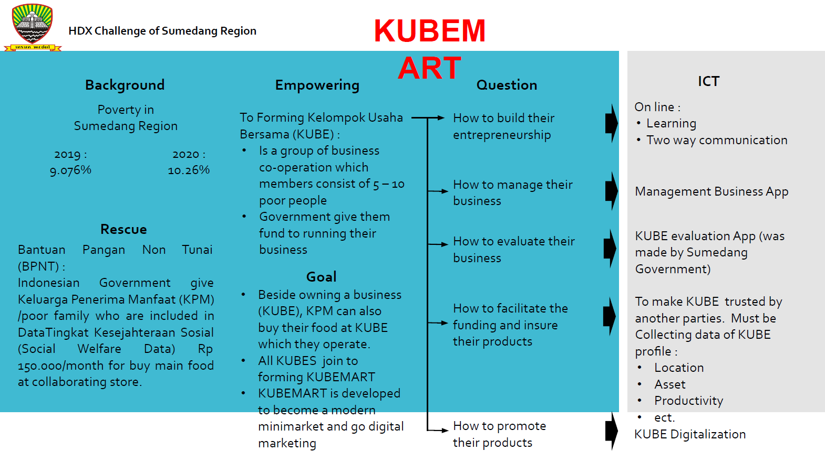
Project Background
KUBEMART

Slide 5
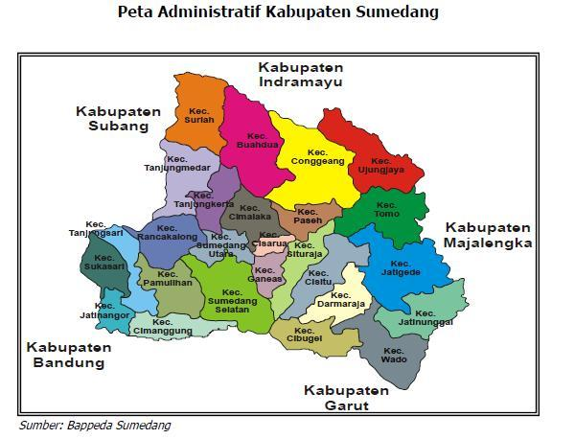
Sumedang
Geographical Challenges :
Distances
Road Condition
Limited Infrastructure (WiFi, Network)

Slide 6
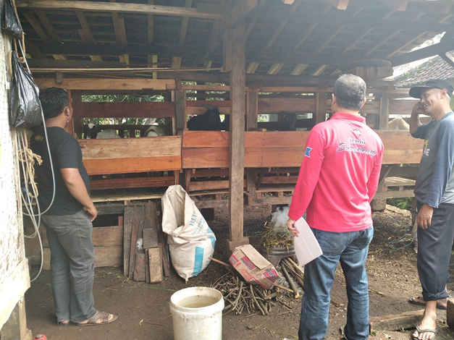
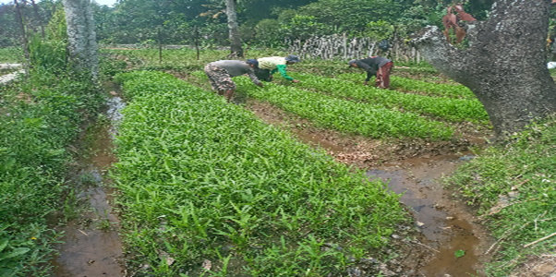
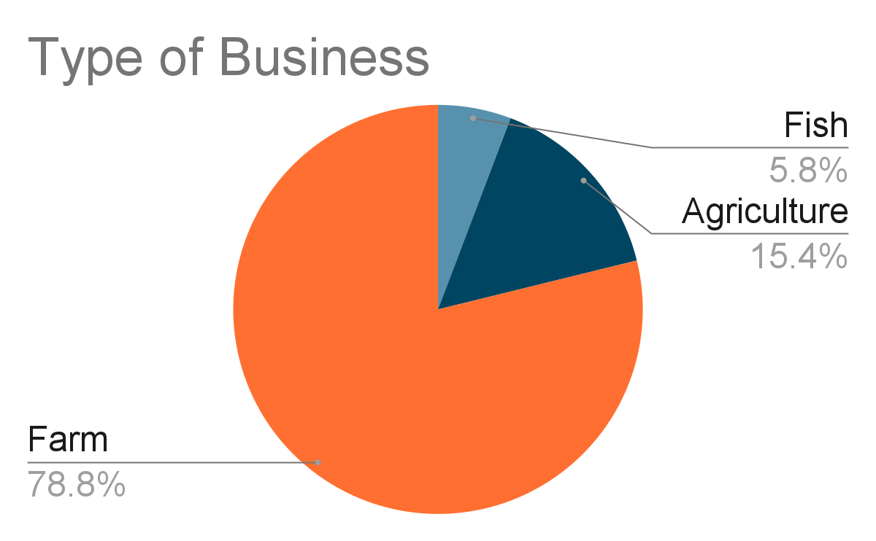
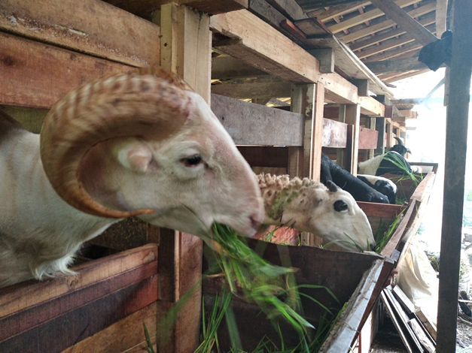
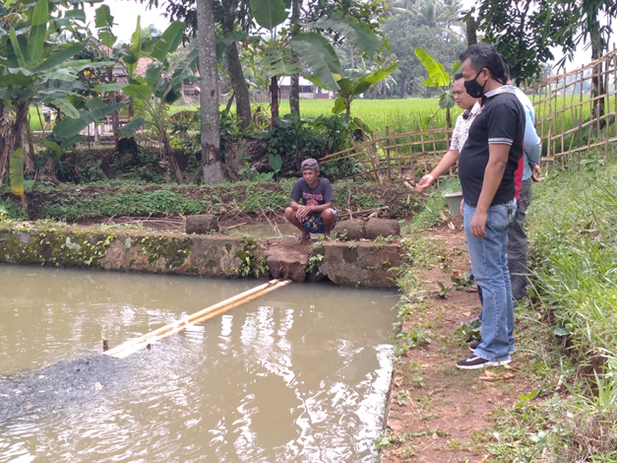
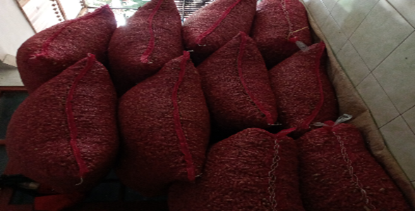
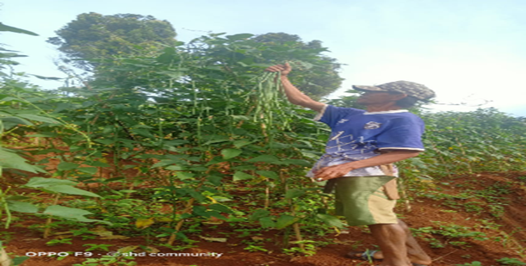
Number of KUBEs & Variety of Products
Infographics
Variety of KUBE’s Products
52 KUBEs that have apps
About 1 Billion Rupiah funding
Across 5 districts
Made in year 2020

Slide 7
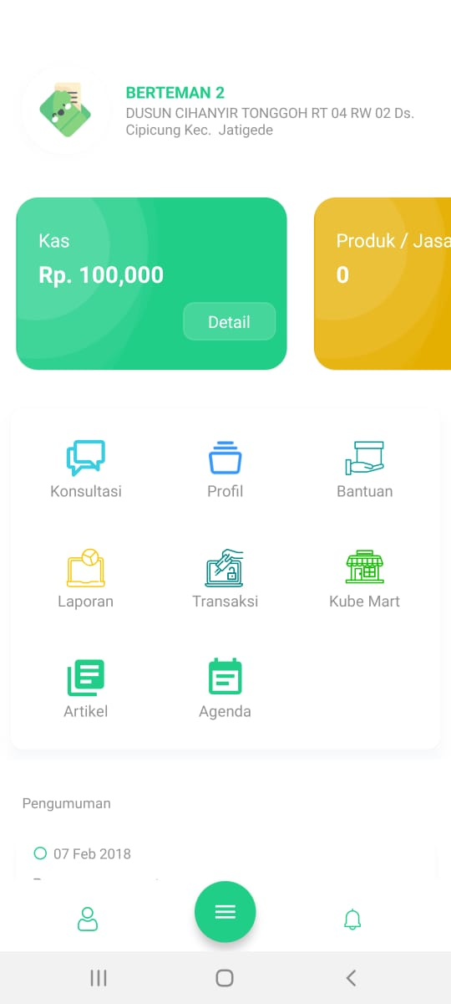
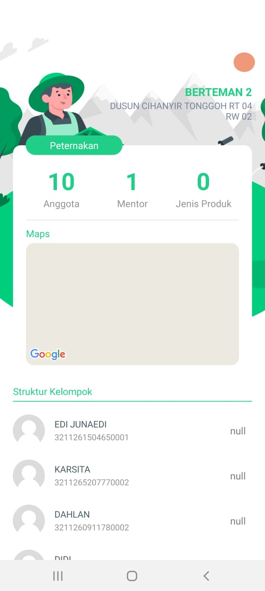








KUBE Apps
Consultation
Profile
Aid tracking
Report
Transaction
Kube Mart
Article
Agenda
52 KUBEs with Apps

Slide 8

Challenges
Event
KUBEs are not well developed and have a low business sustainability
Patterns
The KUBEs are tend to copy another KUBE business (80% KUBEs are goat and sheep farming)
Less enthusiasm
Limitation of the mentors of KUBE
No accountability from KUBE members, there are no commitments to sustain the business
There is no collaboration with another important stakeholders such as University, another government division, etc
Structure
Mental Model
Low entrepreneurship skills
Low entrepreneurial motivation
Low literacy rate

Slide 9
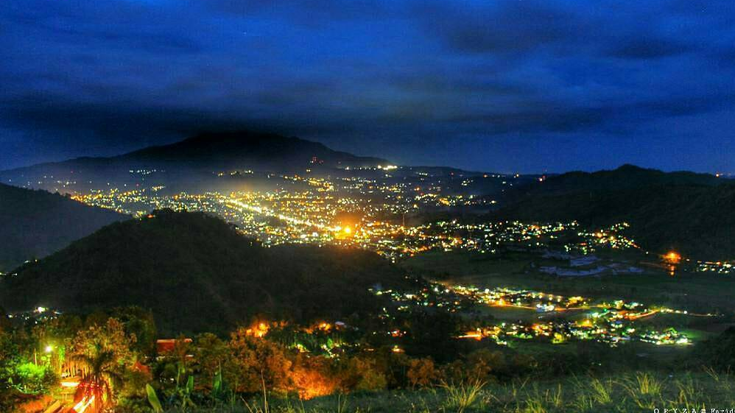
Thank You

